Slide 1
Agenda
Experience
Application Artifacts
Learning’s
Shortcomings
Feedback

Slide 2
Experience
Working on a project with 5 people in a team was entirely a new experience for every one.
Since our project was to develop a real time scenario of Buyer-Customer relationship each member had to put himself into the scenario to develop different modules.
The above task was quite challenging but not impossible.
And each and every member did their job with utmost sincerity and dedication.
Most wonderful part of our team was that every member had a good rapport with each other ,thus a common understanding was present every time.
Every member felt a splash of joy once our project had been wholly completed since some exceptions were creating a strenuous time during the course of our project.
Thus Gladiator phase which is usually considered as a “tough” went with ease and comfort, thanks to the members and mentors guiding our team.
Notes:
Experience:
Talk about your experience (the entire team’s experience) during the project.
Talk about how the team members felt working on the project.

Slide 3
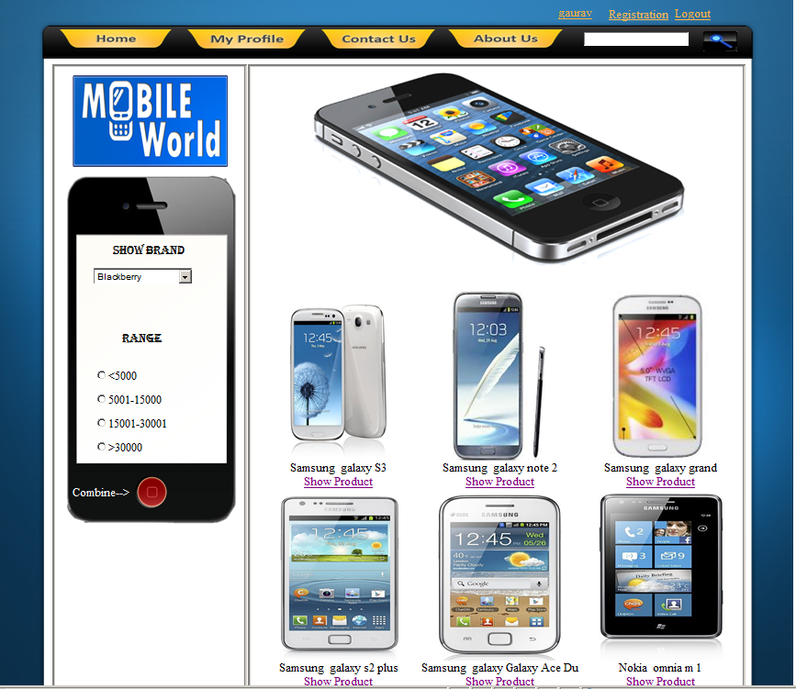
Home Page

Slide 4
Application Artifacts
Some of the artifacts used in our presentation can be listed below:
Use Case Diagram
Activity Diagram
Notes:
Application Artifacts:
Talk about the different artifacts created during the project
Like: FRS, Use Case, Test case, Test Script, Code Construction, Testing & Performance
You can also paste the snap shot of the artifact.

Slide 5
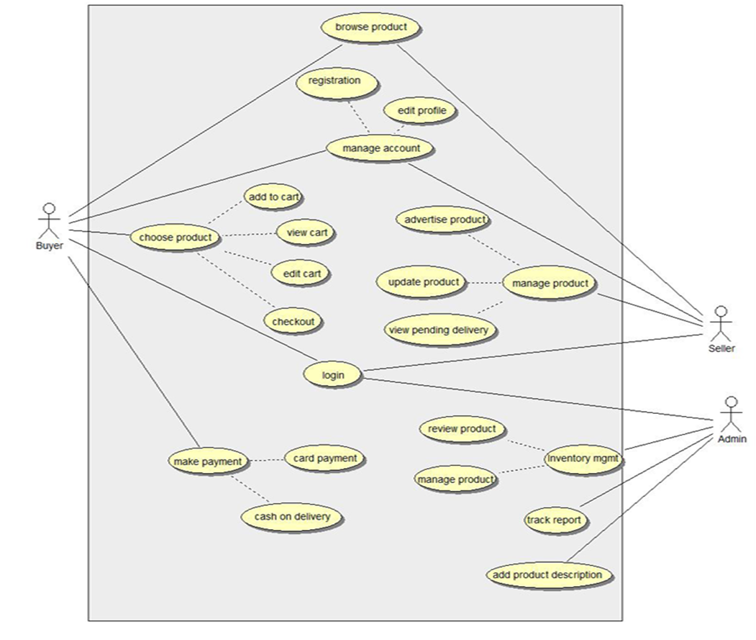
Proprietary & Confidential © L&T Infotech

Slide 6
Activity diagram for Customer
Cancel
Entering the website
Browse the product
Select a product
Product page
New user
Registration
Existing user
Cart page
Login
View Cart
Payment page

Slide 7
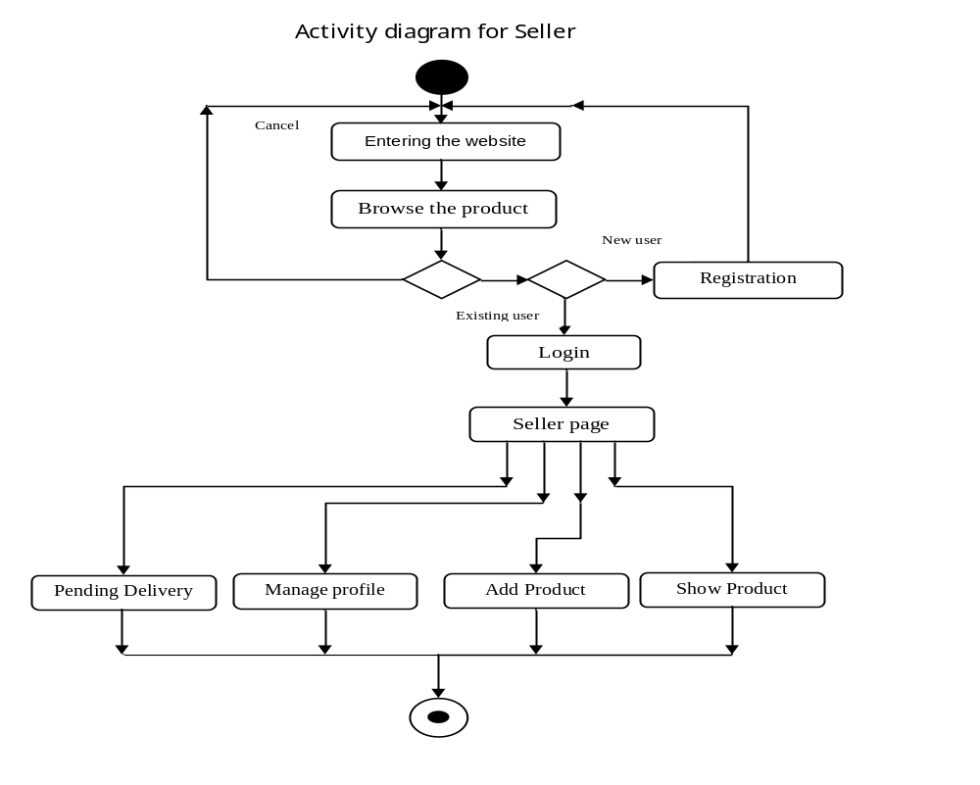

Slide 8
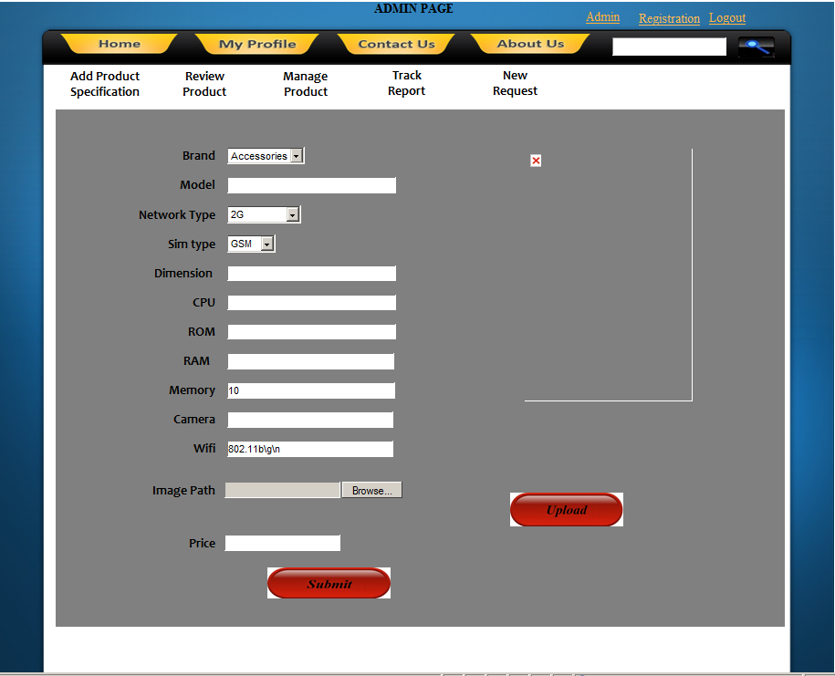
Admin Page

Slide 9
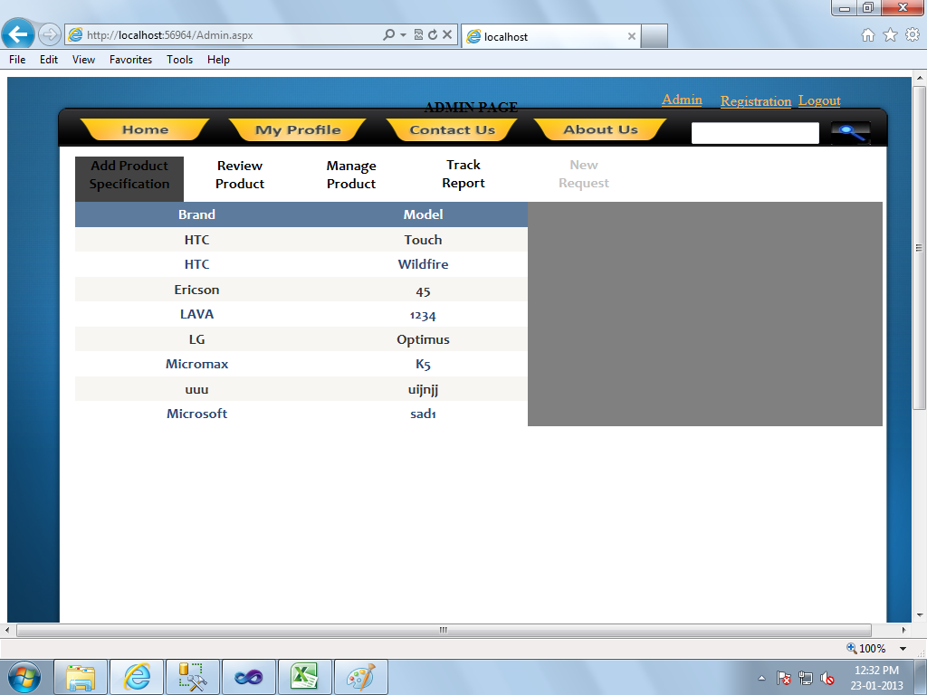
Admin Page

Slide 10
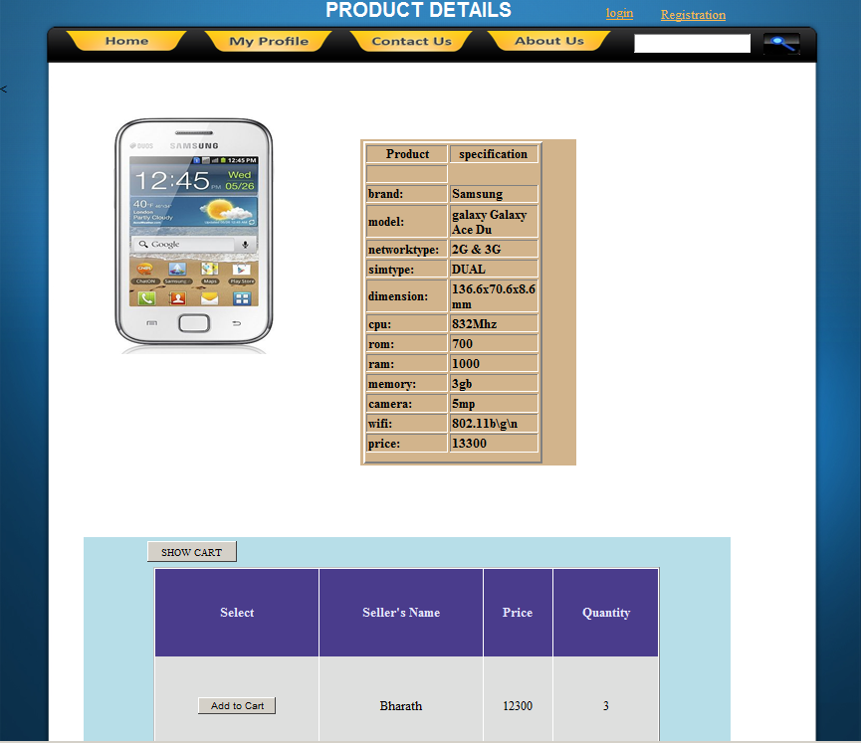
Product Page

Slide 11
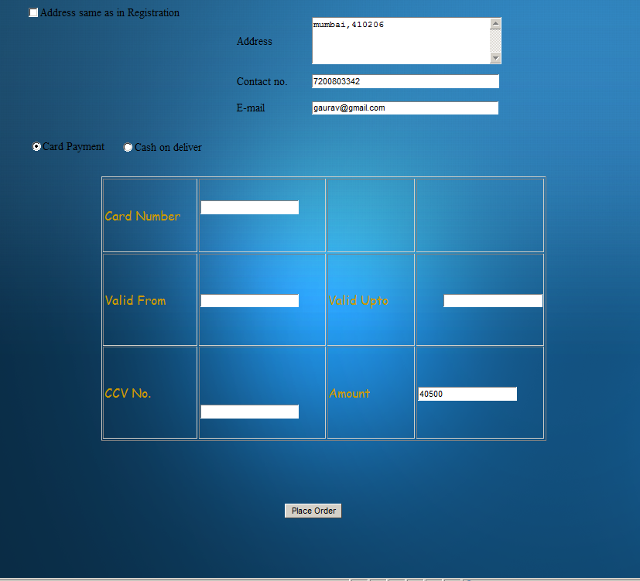
Payment page

Slide 12
Technicalities
Front-end: ASP .NET using C#
Back-end: Microsoft SQL SERVER 2008 R2 Edition
Architecture: 3 Tier architecture using Class Libraries.

Slide 13
Learning’s
Always implement the said pages using a proper template.
Always listen to your co members, maybe they have a better logic than yours’.
Exception handling proved to be of a great help while testing the project because it was this phase where we were subjected to various exceptions which had never been heard of.
Always try to display User-friendly messages to the client because your business ratings increases only when more and more people access your website.
Notes:
Learning’s:
Talk about what according to you (the group) have you learnt on the this project.
What do you think will be very valuable to you (the group) in the future?
Also talk about things that you (the group) think you will keep in mind in the future when you work on a real project, so that either you don’t repeat the mistakes you made here or be better prepared for it.

Slide 14
Shortcomings
Coding Standards were implemented after PMs’ suggestions leading to repetition of some works.
Connection String used in the WebConfig file was not properly encrypted .
A bug table was created at the n-th hour leading to more work at the last moment.
Time management was one factor which were lacking in because some modules were not getting completed in the allocated time.
Notes:
Shortcomings:
Talk about things, that you (the group) think should have been done differently or if there were things missing.
Give your suggestions on the entire execution of the project which can be helpful in future similar projects.
Mention the thing that the group thinks they could’ve done in a better way or the one thing that the group was lacking in (the group’s handicap).

Slide 15
Feedback
It was Interesting and Challenging to work in teams
The most challenging part was handling errors and handling the exceptions
We felt a splash of joy once our project had been wholly completed
Notes:
Feedback:
Mention one sentence from each member of the group on what they felt about the project.
Mention the most challenging part of the project (as per the group).
Without putting it on a slide, mention names of people you would like to thank.

Slide 16
Thank you
<Team Members>

